Slide 1
Discovery Project Management Overview
June 2024 Onboarding
May2024v2

Slide 2
Agenda topics
Intro to Discovery Project Management
  How is it different?
Scope
  Where does Discovery sit within the pipeline?
  What do we do?
Pre-Portfolio
  Pre-Portfolio module in Prism
    Adding new projects – when and how
  TPC Dashboard
    Portfolio Entry timing
    Stakeholder management
Portfolio Entries
  Timing
    Milestone management
  Preparation activities (Checklist) – Process Overview
    Relationship Diagram creation
      DSBs
      New Modalities
    RUAT & Budget creation
  TPC meeting
PE to CI: Management of projects
  Day-to-day (Teams site, Core Team, Lead Team, Ops meetings; minutes)
  Budget management in Dicsovery – documentation and different use of tools
  Timeline management
  BOD meetings

Slide 3
Discovery is Different
Different mindset: Most dynamic and ambiguous space in the pipeline, due to the nature of science
  Requires excellent leadership amidst ambiguity, application of good judgement, calm & firm leadership style
  Very dynamic, often ambiguous. Discovery Project Managers partner closely with Discovery COOs to start adding some shape and structure to project teams, in preparation for Development
More Red CCI
  Teams sites, slides, information; discernment required to assess “need to know”
  Documentation – BOD minutes, partnered assets, etc (pencils down!)
Prism “Superpowers”
  Discovery has Prism access similar to RM&F/PMET
    Best practice: get PMET help with necessary Prism changes and record
    Fail-safe when time is tight: make changes and keep excellent records (RUATs, Change Management Info, etc. – improved process under discussion)
Tools and processes are different (see next slide)
DON’T PANIC!

Slide 4
How is Discovery different? Tools and Processes
Tool/process | Discovery | Early/Late Phase | Rationale
Stakeholder management | Updates to Functions on Portfolio |  | Project milestones and activities move frequently. Functions need timely updates in order to resource our projects
Pre-Portfolio management | TPC Dashboard, Pre-Portfolio module in Prism | n/a | Pre-Portfolio information is Red CCI with restricted access. Not visible in Polaris.
Governance | TPC, BODs | BODs, PIC, PSC | Target Portfolio Committee reviews/approves Target and Portfolio Entry milestones
RD, timeline management | RD = Visio software | RD = OnePager, Detailed Plan | Discovery tasks and timing change frequently, dramatically
Monthly status reports | n/a | In Prism | Manage entire portfolio of projects in Discovery → Quarterly BOD updates (roughly) substitute for monitoring
Risk Management | n/a | Risk Management Tool | Discovery is inherently High Risk; risks called out and updated at governance meetings and communications
Change Management | Occasional use of change management to document major changes in status or budget (not formal PFAs) | PFA, PSE | Significant budget, scope and timeline changes are communicated to/approved by BOD. Leverage Finance. Work with RM&F to update in Prism or update yourself, with documentation in Change Management
Business Plan | Light lift, High level involvement | Defined process involving PFAs | Close collaboration with Finance. Ensure milestones through Launch are directionally correct and CMC, Tox spend is in the correct timing
Strat Plan | n/a | Defined process | Very early in pipeline; frequent changes, projects Parked, Terminated, etc
TimeCard | All project hours go into Multi-Molecule | Hours are applied to individual projects | Discovery has many projects per COO/PPM team, making it time consuming to tease apart into individual projects

Slide 5
Scope

Slide 6
Drug Development Phases
Discovery
Sustainable flow of innovation
Candidate
Selection
Commercial Decision
Target Identification
and Validation
Lead
Optimization
Prepare First Human Dose
Phase 1
Phase 2
Phase
3 trials
Assay Development
Registration
Launch
Post Launch
Lead Generation
CORE INNOVATION
Prudent, data-driven investment
POTENTIAL
GAME CHANGERS
Increased
investment
Optimize Portfolio Delivery
GAME CHANGERS
All-in investment
Target Portfolio Committee
Determine Portfolio Entry
Portfolio Investment Council
Determine Investment Strategy
Drug Development Forum
PPM Roles & Responsibilities
PPM Roles & Responsibilities
PPM Roles & Responsibilities
Scope Planning
Schedule Planning
Milestone Management
Trial Initiation and Management
Budget Management
Risk Evaluation
Registration submission planning
Launch activities
Milestone Management
Budget Management
Risk Evaluation
Alliance Management
Right to Operate activities (RTO)
Risk Management
Budget Management
Line extensions/divestments
Alliance Management
Milestone Management

Slide 7
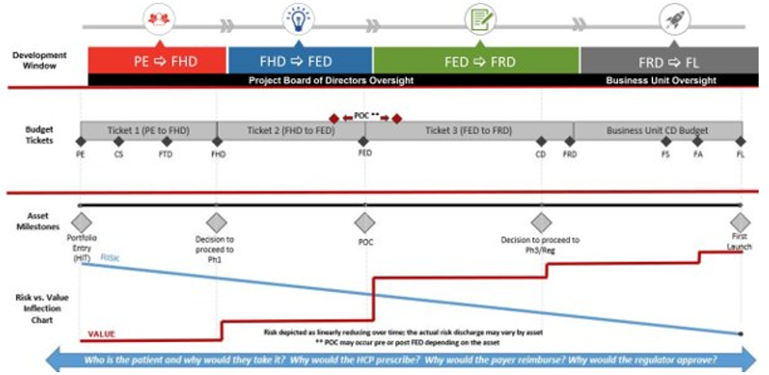
Definition of Discovery Phase
Discovery Phase is made up of two “sub-phases”
  Pre-Portfolio (Pre-Target to PE)
    Identifying/Validating the Target and Evaluation/Execution of molecules to enter the Portfolio
      NGR timing: ~6 months from Target declaration to PE
  Portfolio Entry (PE) to Candidate Identification (CI)
    Timeline is dependent on the modality and degree of technical difficulty
1
2

Slide 8
Discovery Project Management Responsibilities
Idea Generation
(Pre-Target: Target ID to Validation)
Druggability Assessment
(Target Entry to PE)
Optimization/Engineering
(PE to CI)
Candidate Development
(CI to POC)
TA VP proposal and
sponsorship
Target
PE
CI
FHD
Discovery - COO
Early Phase COO
Discovery - PPM
Early Phase PPM
Portfolio Management
Project Management
Other Responsibilities
Partner with TA leadership to actively manage pre-CS portfolio to reflect TA and LRL strategies
Communicate updates to functional leads to enable timely resource assignments
Working with Senior Leadership and Project Leads to plan timing and execution of Target and Portfolio Entries
Coordination and curation of TPC Dashboard data and summaries
Partnership with External Innovation/Alliance Management to bring forward new modality/platform projects to TA portfolio
Main Deliverables/Responsibilities
Lead the team to prepare for target and portfolio entry including coordination of asset profile (NPP) and confidence assessment (Decision Sciences)
Create program file, budget, and RD with input from the team and RM&F
Provide PM leadership to deliver asset milestones on time, on budget, and in scope
Operationalize the team
Other Activities
BOD Meeting leadership in partnership with team leads
Support Alliance Mgmt on external collaboration projects with implementation and execution of work plan
Functional Area partnership (BioTDR/ATP, etc)
Due Diligence Teams
Participate in TA working group and Steering Group to maintain awareness of TA portfolio

Slide 9
Major Milestones: Discovery Phase
In the Discovery phase of development, the major milestones the PPM supports and documents (actualizes) are related to identifying active molecules and optimizing their properties to narrow down to a single Candidate Selection molecule for Development.
  Portfolio Entry typically occurs at the Hit milestone.
    Some exceptions occur, where projects enter at Lead, Candidate Selection, and later milestones.
Discovery
Target:
Sufficient evidence demonstrates that modulating the Target will impact a disease phenotype, and the Target fits into TA’s Strategy.
Hit:
Molecules with desired Target modulation properties have been identified. Asset Profile and differentiation strategy are defined with sufficient detail to prosecute the flow scheme.
Portfolio Entry (PE):
A project officially enters the Portfolio & team receives approved scope and budget for execution to FHD. This marks a broadening of the project team and increase in the use of functional area resources.
Lead:
1 or more molecules or a chemical scaffold has been identified that has the potential to produce a CS molecule. Milestone approved by governance.

Slide 10
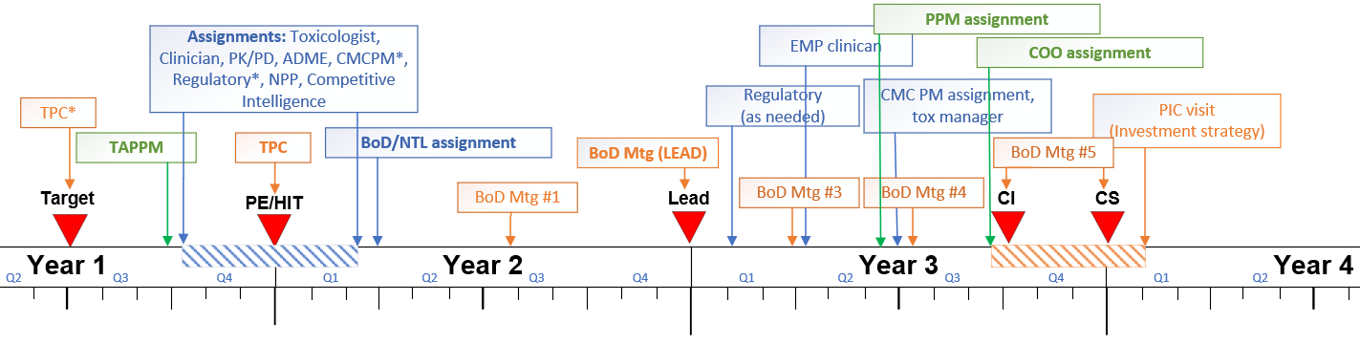
Timeline to Early Phase COO/PPM handoff (*changes pending)
(milestone timing different across modalities)
*as needed
* siRNA only
Target conviction/opportunity evaluation
Onboarding
Initial Timeline/RD
Initial budget estimation
Confidence Assessment
Asset Profile
Initial Clinical Plan
NTL onboarding
Delivery to flow scheme while navigating science
1st BoD Engagement
Optimize timeline & budget
Tolerability/Pilot tox planning
Timeline optimization
Budget management
Pre-IND &/or INTERACT planning (as needed)
Clinical planning kick off
Continued Asset Profile development
CMC strategy and funding triggers
GLP tox planning

Slide 11
Discovery Portfolio Management (updated paradigm under development)
PE
PE > 3 Quarters Out
PE within 3 Quarters
PE in 1 Quarter
Aware
Monitor
Engage
COO & PPM aware of targets within TA portfolio
COO & PPM monitoring
assets nearing PE
COO & PPM engaged with asset teams; COO leading team towards PE
PPM Leadership monitors progress of discovery portfolio to assign resources when appropriate and ensure portfolio progress

Slide 12
Transition Timing and Key Deliverables
Candidate
Identification
Candidate
Selection
Target of Interest
Target Entry
Portfolio Entry
 | Target Validation | Target Evaluation | Target Execution | PE to CI | CI to CS
Discovery PPM
Discovery COO
Early Phase PPM
Early Phase COO
Around CI: Project transfers from Discovery PPM to Early Phase PPM and begins transition from Discovery COO to Early Phase COO

Slide 13
Pre-Portfolio to Portfolio Entry (PE)
PE preparation, Budgets, Timelines

Slide 14
Drug Development Teams – Discovery is Different
In Discovery, teams have different functional partners from other phases of development
Sometimes added to teams for consultation:
  Regulatory
  EMP
  Statistics
Governance from PE to CI is your BoD, similar to Early Phase (possibly pending change)
Target
PE
Lead
CI
CS
Discovery Phase
Discovery
(TA + MIH)
Competitive Intel
ADME
NPP
Tox
Decision
Sciences
COO PPM
MIH STL
PK/PD
Legal
PDPM (CMC PM)
Finance
Alliance
Mgmt
Clinical
Notes:
As project managers, it is our responsibility to integrate across functions supporting drug development and to lead the team.
Project management is a central hub and integration point for the drug development team.
This includes integrating information, ideas, people, deliverables.
PPM responsibility to play a role in integrating functions together to advance the development of drugs.

Slide 15
Key Stakeholders
TA VP(s), MIH VP
  Always make sure VPs are aligned/aware of team requests, project status
BoD
  Your BOD should be aligned with the team’s changes to plan (scope, budget, timeline)
Fellow Discovery COO/PPM teams – learn from each other!
  Someone else may have recently been through a process that is new to you
Functional Contacts: Tox, ADME, PK/PD, CMC, Clinical, EMP, Decision Sciences, NPP, Competitive Intelligence
  Keep these contacts informed on portfolio movement, so they can prepare to resource your projects at the appropriate time
Finance, RM&F/PMET
  Great partners in creating and managing budgets
Legal
  Discovery deals with Intellectual Property (IP) daily. Stay in touch with legal while you protect Red CCI
PPM org
  Have a sticky wicket? Touch base with your supervisor and/or Early Phase COOs if guidance is needed

Slide 16
Managing New and Existing Projects
Target to CI Checklist
  Hands on examples, Q&A
  This checklist has links to the key tools and processes for starting a new project and managing it through the CI milestone
    Bookmark it
    Review tools before you need them
    Reach out for help
    Update the links when tools or processes change (pay it forward!)
  Discuss with TA Transition Coach who are the functional contacts who assign support for your projects

Slide 17
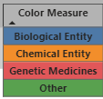
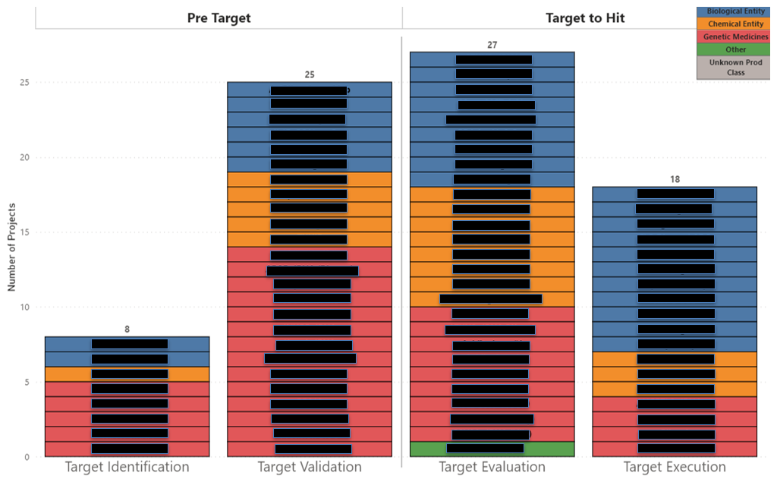
Pre-PE Portfolio Snapshot
Color coded by molecule cassification
Pre-PE Portfolio Snapshot – TPC Dashboard
Color coded by molecule cassification

Slide 18
Major Milestone Accuracy is Vital; Milestones Change Frequently
Major milestones are foundational to managing assets and the overall portfolio.
  Each asset is part of a larger and dynamic portfolio, and PPMs must effectively communicate key project information via R&D project systems (e.g., Prism, Polaris).
  Many development activities occur in the background, without direct involvement of PMs and asset teams.
  These data points are visible enterprise-wide and must be relevant and accurate in real-time.
Major milestone data is used at all levels of the company and informs key decisions made by executive leadership.
  Therefore, the accuracy of milestones is directly impactful to the portfolio.
  Milestones are vital inputs to key business planning, decision, and reporting activities.
Teams in Project & Portfolio Management Relying on Milestones
External Innovation
Survey marketplace for new opportunities
PM Strategy and Capabilities
Process ownership & budget management
Portfolio Strategy & Competitive Intelligence
Measure pipeline and compare to competitive landscape

Slide 19
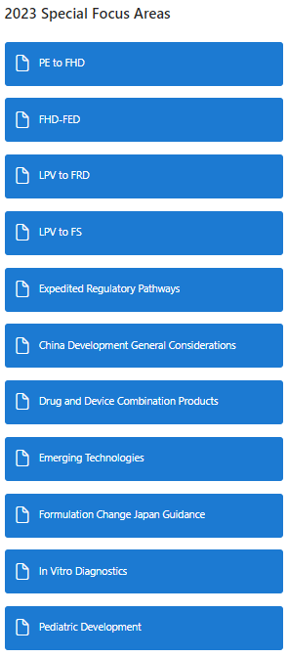
DSBs for Discovery : What Diseases are Covered by the DSBs?
What if your new project’s indication isn’t on the list?
Disease Area | 2023 DSB
Diabetes and Diabetes Complications | Type 2 Diabetes Non-Insulin
 | Insulin
 | Heart Failure (HFrEF, HFpEF)
 | Obesity
 | CKD – advanced disease (S3+)
 | ASCVD
Neurodegeneration | Alzheimer’s Disease (Disease Modification) – Include guidance on Lewy Body Dementia
 | ALS / RNA, Gene Therapy
Pain | Migraine Pain (Acute and Chronic)
 | Chronic Pain (OA, CLBP, and DPNP)
Oncology | Oncology
Immunology | Rheumatoid Arthritis (includes guidance on PsA, AS, AxSpa)
 | Lupus (SLE) (still under development)
 | Psoriasis
 | Atopic Dermatitis, inc AA
 | UC and Crohn’s Disease (include guidance on EOE if determined by DSB team)
One size does not fit all. New Modalities are constantly being brought in which adds to increased complexities. Work with functions to right size or be directionally correct. Start with modalities that have longer timelines and work from there. Questions to ask when starting a program:
Do the CMC timelines and budget make sense for the project? Is there conjugation between different molecules – this adds time and spend to mfg both pieces
Are there additional Tox studies that will need to be perform?
Is there an additional function that needs to be brought in? (example ARCs require BioTDR and GenMeds)
Review with team and functions to see if changes make sense
… 2023 RDs
Notes:
Specific diseases are chosen by what is currently in the portfolio and what is anticipated in the near future.

Slide 20
Milestone Confidence Levels – Discovery
A confidence level applied to a major milestone provides operational certainty of achieving that milestones.
  Provides more granularity for other groups reviewing the portfolio to make decisions.
Downstream milestone confidence levels should be viewed as the possibility of achieving them within 1Q of predicted date.
  Best Practice: As a project progresses and achieves a milestone, downstream milestones within that year should be updated to Medium confidence, if they were listed as Archetype
Discovery:
Because the Discovery space is both very dynamic and often ambiguous with new modalities, Confidence Level tends be either Medium or Archetype
Exceptions:
  When a project has selected a PE date and the TPC time slot is scheduled, change the PE probability to High
  Archetype is sometimes used for a new modality to create some order and a starting point, even though a DSB does not exist (and therefore there is no archetype)
Confidence Level: | Parameters:
HIGH​ | >80%​
MEDIUM​ | 50-80%​
LOW​ | 25-50%​
VERY LOW​ | <25%​
PENDING CHANGE​ | Milestone date is in flux or not yet governance approved
ARCHETYPE | Milestone date not yet planned ( > 18-24 months out)

Slide 21
Discovery budgets – Building and Maintaining
Pre-PE
  Lead team through RUAT, document and make changes in Prism if different from Archetype PE-FHD for your modality
  Upload modified RUAT to PMO site for documentation
  Update milestones in Prism for your project
  Pull budget and add high-level bullet to TPC slide deck cover page, noting cost and any significant differences from Archetype
Post-PE
  Pull budgets periodically to make sure team is on track
  Frequency depends on current activities and TA, Finance’s preference
When in doubt, reach out
  Finance, RM&F/PMET, Functions

Slide 22
Portfolio Entry to Candidate Identification (CI)

Slide 23
PE to CI Team Management
Once your team has achieved PE, the Discovery COO/PPM team is responsible for:
  Driving teams to achieve approved plan to CI/CS on time, on budget
  Create some structure, in preparation for handoff to Early Phase Development
  Recurring meetings recommended:
    Core or Lead Team (STL, MIH Lead, COO, PPM, key functional leads)
      Leads provide updates on key data readouts; COO/PPM monitors deliverables and updates timeline, budget
      Smaller than Working Group meetings and less focused on day-to-day scientific details
    Ops or Strategy Team (STL, MIH Lead, COO, PPM only)
      High-level plans and team progress/health discussions; little science discussed
  Consider creating a Core/Lead Team Team’s site (Label it Red CCI, make Private)
    Get team organized
      Add PM operational tools, folders for governance slides, etc (i.e. meeting agenda tracker, action item tracker, RD, BOD slides)
  Check budget periodically to keep team on track
  Update RD when needed
  Communicate, communicate, communicate

Slide 24
How to be successful in Discovery?
Linda and Beebs’s - Top 5:
  Listen
    “Seek First to Understand” principle – Steven Covey
  Ask questions and be humble
    Discovery is just that – science is inherently humbling ☺ there’s so much to learn and find creative solutions to make new medicines! Be brave to say “I don’t know” or “I don’t understand” – you can lead clarity in communications for teammates and stakeholders (act as Translator)
  Communicate to ensure alignment
    Herding cats is a key skill here! Verify that your VPs and functional partners align
  Establish strong relationships with your key partners
    TA VP(s), PMO, RM&F and Functional contacts (Tox, ADME, PR&D, Clinical, Competitive Intelligence, New Product Planning, Decision Sciences). Sometimes it’s more important Who You Know than What You Know (leverage your functions and your network to navigate the ambiguity)
  Be flexible, calm, pragmatic
    This is a dynamic, often ambiguous space to navigate, and your teams need you to lead them through it with calm confidence! Being comfortable with ambiguity is a must

Slide 25
Q&A

Slide 26
BACKUP

Slide 27
Target Portfolio Committee
How we make better and better decisions – Next Generation R&D Portfolio Oversight
Goal
Delivery of more robust scientific targets and drive high quality portfolio entries to fuel the clinical pipeline.
Focus
TA Target Portfolio Strategy and its translation into aligned Target and Portfolio Entries.
Topics
TA Target Portfolio Reviews
Target Entries (as needed)
Portfolio Entries
Performance of Pre-clinical Portfolio
Members
Dan Skovronsky (Chair), Adrienne Brown, Andrew Adams, Barry Taylor, Bill heath, Carl Mcmillian, David Hyman, Elizabeth van Sant Hoffman, Jeff Sevigny, Jirong Lu, Mark Mintun, Mark Genovese, Nisha Nanda, Ramesh Durvasula, Rob Metcalf, Ruth Gimeno, Utpal Singh, Stacy Keding (facilitator)

Slide 28
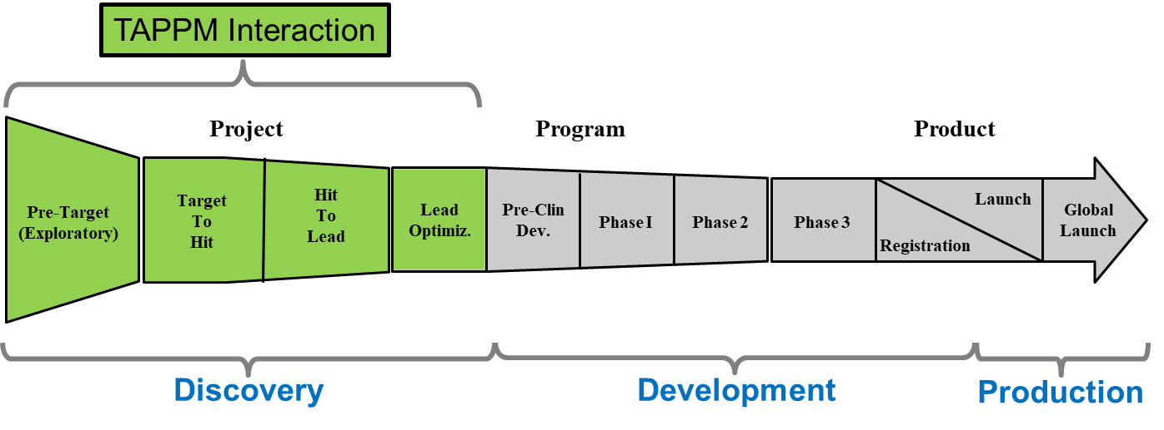
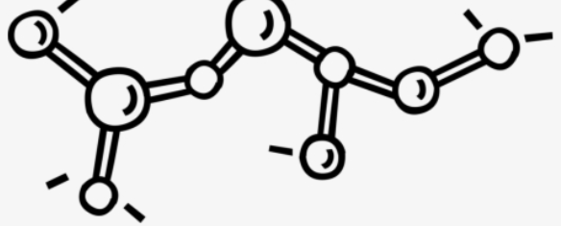

Discovery Project Management:
Leadership in Drug Development Process
Responsible for a portfolio of projects. Includes working closely with VPs and Sr. Directors across functions to ensure strategy and alignment of portfolio, and ensure continuous flow of projects into the Portfolio
Discovery Interaction
TAPPM Interaction
PE
Project
CI
Program
Product
Pre-Target (Exploratory)
Target
To
Hit
Hit
To
Lead
Lead
Optimiz.
Pre-Clin
Dev.
Launch
Global
Launch
Phase I
Phase 2
Phase 3
Registration
Discovery
Discovery
Development
Production
Leads multiple projects from inception to Early Phase COO hand-off. Includes working closely with the TA and functional Scientists and Leadership, Governance Committees, Decision Sciences, Competitive Intelligence, New Product Planning, Clinicians, and BODs (post PE) on each team. In addition, collaborates with TA Liaison to provide periodic TA Portfolio updates.

Slide 29

Prism Pre-Portfolio (“Blue Suitcase”) – Project’s Start in the System
With VP approval, add new projects to the Pre-Portfolio in the Prism module above
Work with team to get the necessary information describing the project
  Important – See the Modality definitions
  Nomenclature – Follow existing projects’ examples, unless specified by VP
  Detailed instructions in TAPPM OneNote Notebook and Target to CI Checklist (see link on previous slide)
This Prism module feeds the TPC Dashboard, which shares information with key stakeholders (limited access)

Slide 30
Milestone Definitions
Target: There is supporting evidence (internal or external) that modulating the target will impact a disease phenotype and it fits within the therapeutic area’s strategy. May require a TPC visit.
HIT: The asset profile/differentiation strategy should be defined with sufficient detail to permit focused optimization with a clear goal of desired attributes. Chemical/molecular scaffold/antibody/sequence with desired target modulation properties (agonist, antagonist, potentiator, etc.) has been identified and its engineering trajectory understood. Druggability should be understood. A connected flow scheme and target pharmacology assays should be in place to enable molecule optimization.
Portfolio Entry (PE): Date a project officially enters the Portfolio (via TPC visit), and the project team has approved scope (PE-FHD) for execution in the Portfolio. Ideal time for PE is when there is a need for cross functional support which typically aligns with HIT for internal SM/LM projects and LEAD with genetic medicine projects. PE dates for collaborations can depend on additional factors including but not limited to legal/contractual obligations, business decisions, strategic decisions, etc.
Lead: Date of identification of one or more molecules or chemical series that have potential to produce a CS molecule as confirmed by the BoD.
Candidate Selection (CS): A decision made with the intention of moving an optimized compound toward clinical development. The BoD makes this decision based on the lead development CSF’s being met.
First toxicology dose (FTD): Date on which the first dose was administered in the first in vivo toxicity study, conducted according to requirements of good laboratory practice (GLP), necessary to support the first ever administration to humans.

Slide 31
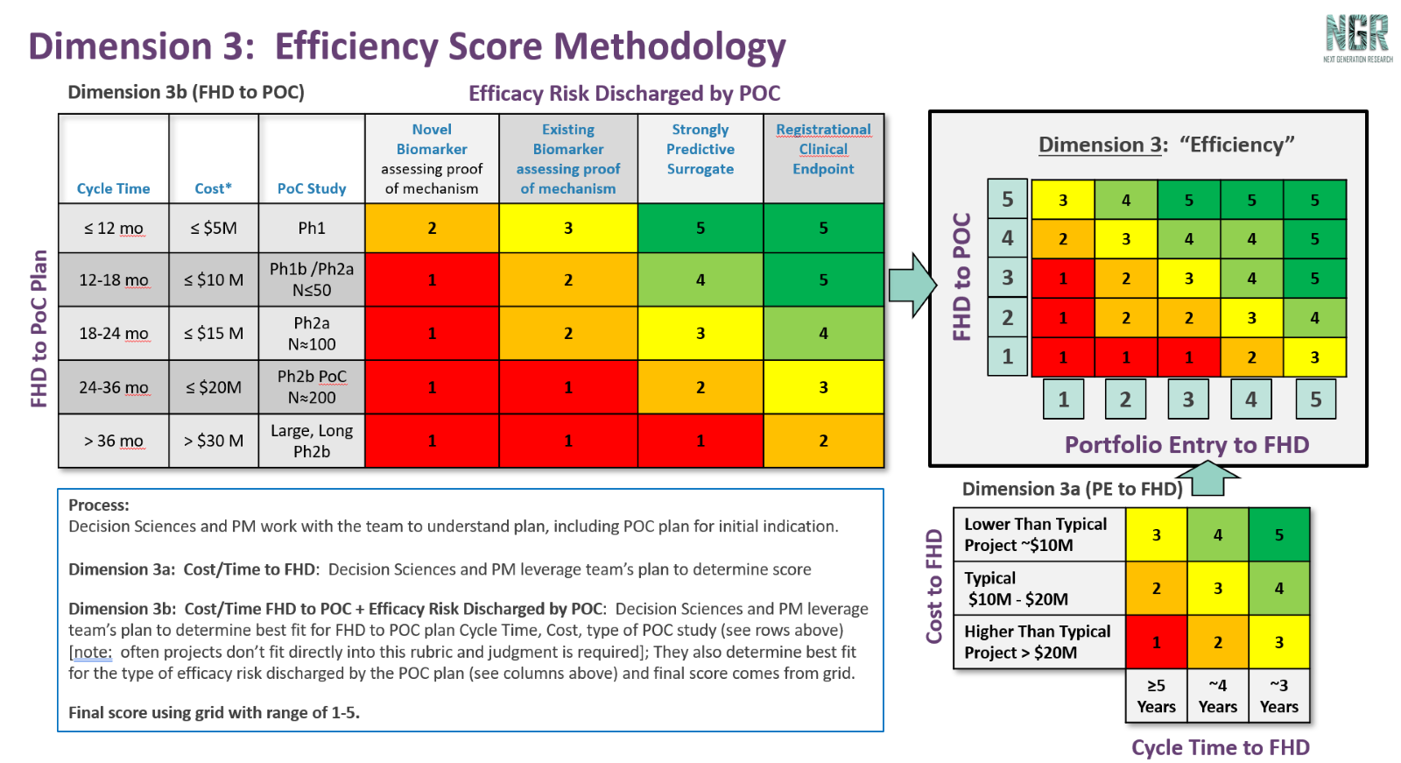
Confidence Assessment information to provide Decision Sciences

Slide 32
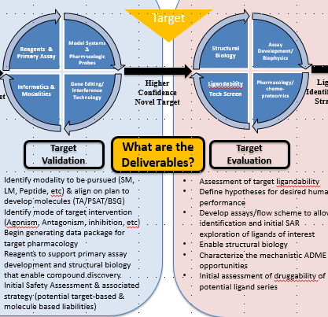
Target Milestone Deliverables
Deliverables
Strategic Fit: Asset profile is on strategy with TA
Compelling Therapeutic Hypothesis/Target Validation: supporting evidence (internal or external) that modulating target will impact the disease phenotype
Molecule Strategy: What modality is most likely to be successful in target modulation and achieving attributes defined in asset profile? Should we parallel process multiple modalities?
Safety Assessment: early assessment to understand potential liabilities of target and recommendations of activities for next stages
Enablement: Primary screening strategy and key assays/reagents are in place to enable hit identification and establish an understanding of target druggability (learning cycles)
Competitive Landscape/Disease State Map: Who are the competitors and what is the status? Define initial differentiation strategy/hypothesis

Slide 33
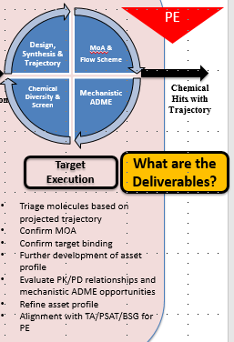
Portfolio Entry Deliverables
Deliverables
Strategic Fit: Asset profile/differentiation strategy is defined with sufficient detail to permit focused optimization with a clear goal of desired attributes.
Molecule: Chemical/molecular scaffold/antibody with desired target modulation properties (agonist, antagonist, potentiator, etc) has been identified. The trajectory of chemical scaffold and Ab/Protein/peptide engineering is understood.
Performance: Druggability of the scaffold (ATP/SMDD)
Biology/Pharmacology: Connected flow scheme and target pharmacology to enable molecule optimization
Risk Assessment and Mitigation Strategy: Enable discussion for PE readiness versus potential risks to delivering within NGR timeline

Slide 34
Timeline to COO/PPM handoff
*as needed
* siRNA only
*
*
*
SM
Lead
FTD
CS
2023 DSB Timing
LM
Lead
CS
FTD
Peptide
CS
FTD
Lead
siRNA
Lead/CI
CS
FTD
PE
siRNA Reality
CS
FTD
PE/Lead/CI

Slide 35
Slides from Onboarding Weeks 1-2

Slide 36
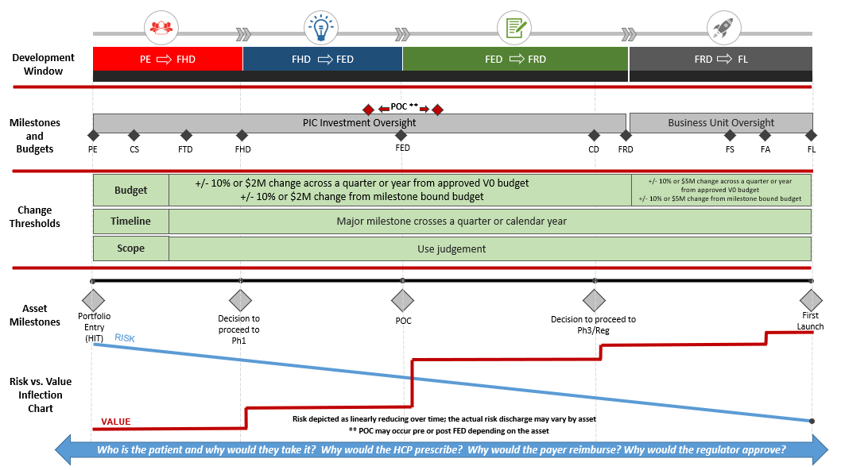
Drug Discovery & Development Framework

Slide 37
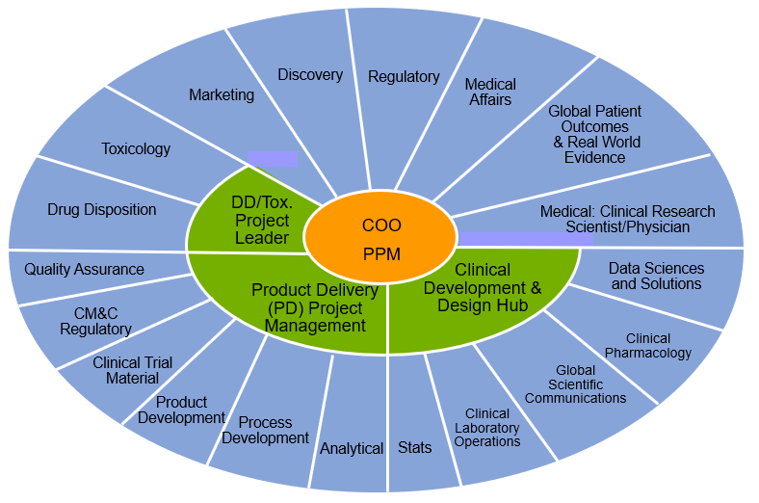
Drug Development Teams (Early Phase to Post-Launch)
Drug development is complex and takes a large team of many functional experts to participate.
We commonly call these teams the asset teams or project teams.
In Portfolio & Project Management, the COO and PPM serve as the integration point where all the functions intersect.
  They are tasked with facilitating a team that can deliver drug development projects within scope, on time, and within budget.
  They lead core teams, track actions, decisions, budgets, timelines (both major and mini), etc.

Slide 38
COO & PPM Responsibilities
Discovery/Early Phase:
Late Phase
Legacy
COO:
Leads the Asset Team
Enables the Asset Strategy
Creation of Integrated Development Plan
Delivery of Integrated Dev Plan
PPM:
Scope Planning
Schedule Planning
Milestone Management
Trial Initiation and Management
Budget Management
Risk Evaluation
COO:
Leads the Asset Team
Enables the Asset Strategy
Creation of Integrated Development Plan
Delivery of Integrated Dev Plan
PPM:
Registration submission planning
Launch activities
Milestone Management
Budget Management
Risk Evaluation
Alliance Management
COO:
Leads the Asset Team
Enables the Asset Strategy
Creation of Integrated Development Plan
Delivery of Integrated Dev Plan
PPM:
Right to Operate activities (RTO)
Risk Management
Budget Management
Line extensions/divestments
Alliance Management
Milestone Management
Determine Investment Strategy

Slide 39
Roles in the Development Process
Discovery
(PE – CS)
Early Phase
(CS-FED)
Transition from LRL to BU
Late Phase
(FRD-FL)
Post Launch/Legacy
Discovery PPM
Pharmaceutical Project Manager
Legacy PPM
Discovery COO
Early Phase COO
Late Phase COO
Toxicology (Tox) /Absorption Distribution Metabolism and Expiration (ADME)/Pharmakokinetics/Product Delivery (RTO)
Regulatory
Regulatory
Clinical (consult)
Clinical
Clinical
Stats
Stats (RTO support only)
Medical
Medical
Chemistry Manufacturing and Control (CMC)
CMC
Design Hub
Global Patient Safety (GPS)
GPS
Finance
Finance
Exploratory Medicine and Pharmacology (EMP) (RTO support only)
New Product Planning (NPP)
Marketing
Med Affairs
Value Evidence Outcomes (VEO)
Submission and Approval Expert Network (SAEN)
Notes:
PPM is an integral part of the development process regardless of phase. Collaboration with other functions may vary across the development phases but a key partnership will be that of the PPM and COO.
RTO=Right to Operate

Slide 40
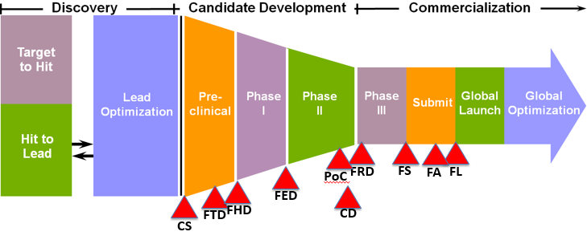
Drug Discovery & Development – Process Overview
The drug development process can be divided into three development areas:
PE
POC
FRD
Lead
CI
Discovery Phase
Early Phase
Late Phase

Slide 41

Portfolio Entry:
TPC approves scope and budget from PE to FHD
~ 6 months
TPC visit
30 months
= 36 months, PE-FHD
NGR Starts Here
TA approval
Discovery COO/PPM team support begins
TA & MIH governance visit
FHD
Discovery Budget
Target
PE
Portfolio Budget
CS
POC
CI
Idea Generation
TA VP proposal and
sponsorship
Druggability Assessment
Establish project code
Optimization/Engineering
(PE to CI)
Candidate Development
(CI to POC)
TA VP proposal and
sponsorship
Should we pursue Idea?
Can we drug the target?
Can we optimize a molecule?
Should we test in patients?
TA and Functional alignment on target
Identify Target
Explore Target
  MOA hypotheses
  Preliminary asset profile
  Molecule modality
Prep Tools to enable next phase
POC clinical hypothesis defined
Align on plan to develop molecules for target
Safety Assessment
  Define hypotheses for desired human performance
Develop assays/flow scheme
ID chemical matter and evaluate trajectory
Confirm MOA (SM)
Confirm target binding
Evaluate mechanistic ADME opportunities
Further development of asset profile
Align w/TA for PE
Target Engagement/MOA: in vitro & in vivo (LM)
Optimize desired human performance characteristics
Refine the chemical-physical properties
Refine PK/PD Relationship (exposure/response)
Engage CMC for planning
Establish Program Team to enable Development planning
Drug substance process for API (Tox and FHD)
Drug product development to support clinical studies
GLP Tox studies
Final clinical strategy and planning
IND filing
Clinical plan will test hypothesis
RIGHT TARGET?
RIGHT TARGET STRATEGY?
RIGHT MOLECULE?
RIGHT CLINICAL STRATEGY?

Slide 42
Portfolio Administrative Milestones
These are milestone that are not forecasted, but are entered into Prism as needed, based on the administrative task at hand.
  Initiate: Date the project is created within our Portfolio Management Systems and we have started to track progress on the asset. This can be at or prior to Portfolio Entry (PE). This is critical to capture in the Discovery space.
  Termination: Date at which an R&D project is removed from the active Lilly Portfolio due to a governance decision or an outright divesture of a Lilly asset. (Lilly no longer makes decisions, conducts development work, or funds activities.) Also critical for Discovery – accuracy matters, and timing of “sharing” requires good judgement.
  Parked: Date at which an R&D project is considered to be inactive (no longer part of the active Portfolio) but does not meet the requirements described by a termination. Entry into Parked status is intended to be a short-term status (less than 6 months) for unfunded projects with the strategic intent of future value creation based on reactivation of active development at a future date. For these projects, no new development activity or investment is planned beyond the governance approved in-scope completion of work as outlined in the “parked resource plan”. Following completion of parked resource plan, only minimal LRL/BU resources will be applied to support partnership seeking or attendant out-licensing activities. Projects will be placed in this status pending:
  Reactivate: Date which a parked or terminated asset re-enters into the active Portfolio, and the project team has approved scope for execution in our Portfolio.
  Alliance Start: Date a contract is signed with an alliance partner.
  Alliance Stop: Date a contract is terminated with an alliance partner.

Slide 43
A glimpse of our diverse Discovery portfolio & unique challenges
(from COO presentation, Sept 2023)

Slide 44
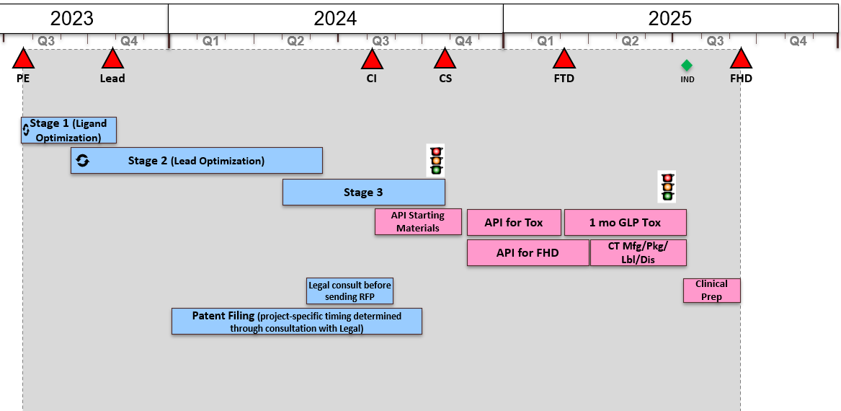
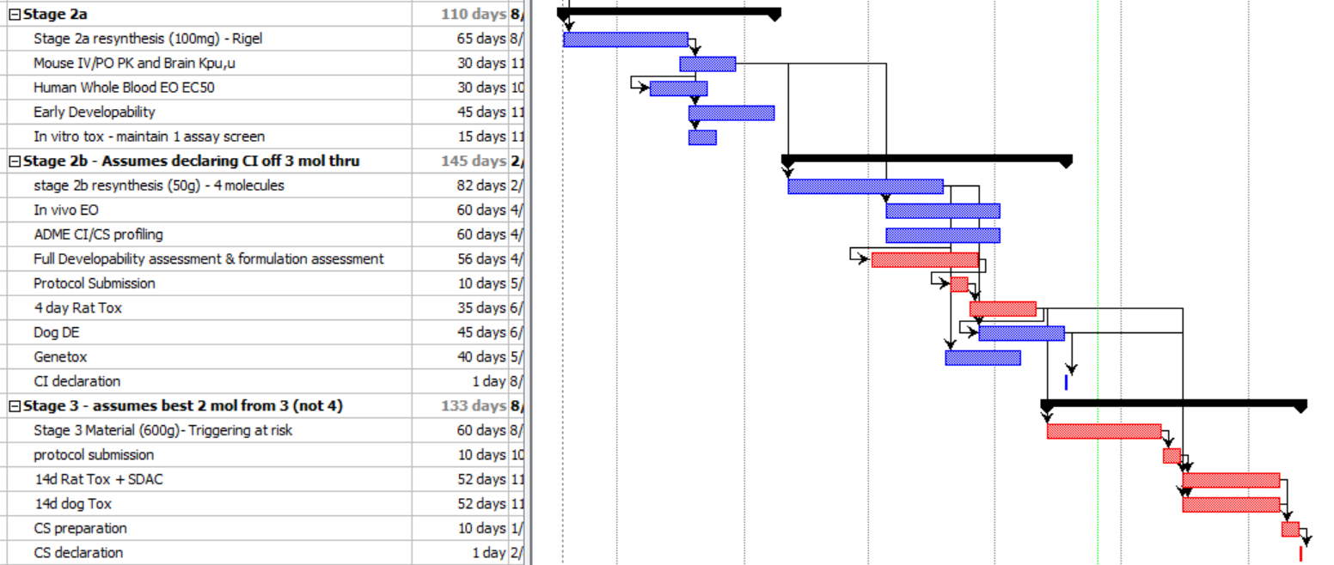
Small Molecule
Not much has changed. Few opportunities for acceleration.

Slide 45
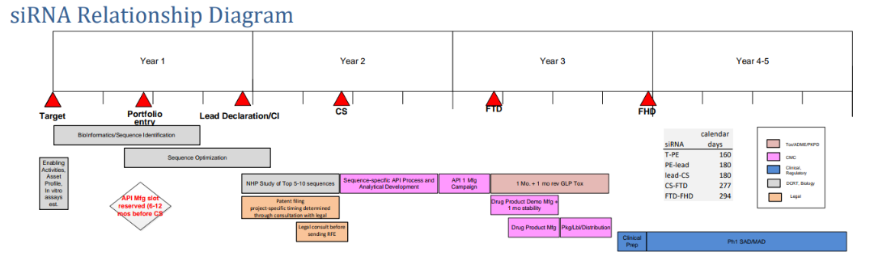
siRNA 2021 RD
Built off very limited experience

Slide 46
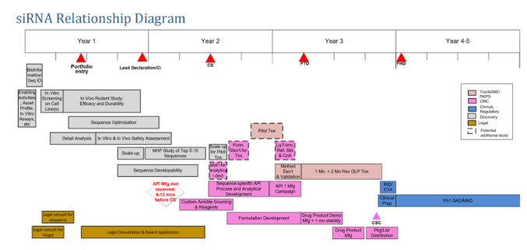
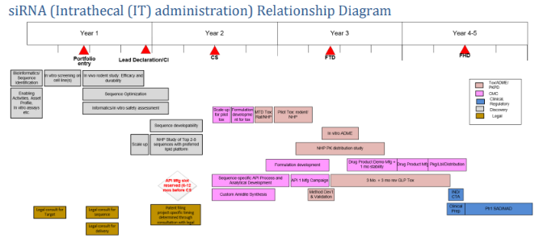
siRNA 2023 RD – Lots of learnings in two short years
New archetypes for CNS (IT administration) & Non-CNS (GalNAc conj)

Slide 47
Orientation: Target and Molecule Identification Engine
Idea Generation: Should We Pursue the Target?
Druggability Assessment: Can We Drug the Target?
Bioinformatics
Clinical ‘Omics
Literature & Academic Collaborations
Functional Screen Information
Model Systems & Pharmacologic Probes
Gene Editing/ Interference Technology
Informatics & Modalities
Reagents & Primary Assay
Target
Assay Development/ Biophysics
Pharmacology/chemo-proteomics
Ligandability
Tech Screen
Structural Biology
MoA &
Flow Scheme
Mechanistic ADME
Chemical Diversity & Screen
Design, Synthesis & Trajectory
PE
Potential
Novel Target
Higher
Confidence
Novel Target
Ligand
Identification
Strategy
Chemical
Hits with
Trajectory
Target
Identification
Target
Validation
What are the Deliverables?
Target
Evaluation
Target
Execution
What are the Deliverables?
  Assessment of target ligandability
  Define hypotheses for desired human performance
Develop assays/flow scheme to allow identification and initial SAR exploration of ligands of interest
Enable structural biology
Characterize the mechanistic ADME opportunities
Initial assessment of druggability of potential ligand series
Identify Target
Has target pathway been validated?
  Preclinical
  Clinical
Does manipulation of target affect disease hypothesis?
Preliminary Asset Profile
TA and Functional alignment on target
Identify modality to be pursued (SM, LM, Peptide, etc) & align on plan to develop molecules (TA/PSAT/BSG)
Identify mode of target intervention (Agonism, Antagonism, inhibition, etc)
Begin generating data package for target pharmacology
Reagents to support primary assay development and structural biology that enable compound discovery
Initial Safety Assessment & associated strategy (potential target-based & molecule based liabilities)
Triage molecules based on projected trajectory
Confirm MOA
Confirm target binding
Further development of asset profile
Evaluate PK/PD relationships and mechanistic ADME opportunities
Refine asset profile
Alignment with TA/PSAT/BSG for PE

Slide 48
Portfolio composition by modality has evolved since 2017
Candidate Selections Achieved (2017-2022) | Breakdown of Candidates (%) by modality
Antibody
Peptide
Small Molecule
siRNA
Antibody Drug Conjugate
Company Confidential © 2023 Eli Lilly and Company
48

Slide 49
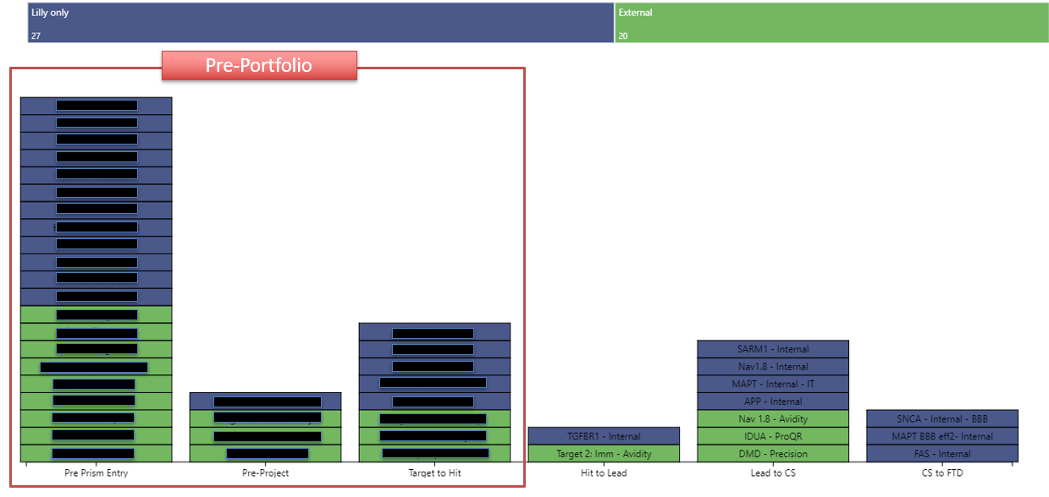
The evolution continues – internal vs external LGM efforts

Slide 50
Key Takeaways
Takeaways:
As we expand into new/novel modalities (siRNA, ADCs, ASO, AAV, gene editors) we also find ourselves diving into more rare conditions, exploring new delivery methods and engaging in more early collaboration efforts. Adding layers of complexity to projects.
Outsourcing more than in years past across functions (e.g. mfg, GLP tox, chemists) which adds complexity, time and cost. NGR timelines require high risk spend commitments earlier requiring more judgement-based decision making for even “standard” projects.
Archetypes and models cannot keep pace with the changes. The lack of accurate models leads to more unpredictability with regards to timeline and cost and lots of time-consuming manual manipulation for early program projections.
Early cross functional resource constraints and expertise limitations due to new modalities/indications, limit the amount of detailed planning that can be done prior to COO/PPM handoff. We don’t know what we don’t know!
For many collaborations, Lilly is not making decisions in silo. Partnering for expertise, to address capacity issues, technological advancements, etc. We’re leaning on external partners to help guide our indication selections and development package. Trial and error on collaboration contract designs. Partnerships are complex and all different. Collaboration/contractual terms matter. Impact on not just deliverables but relationships.
Take a closer look on our approach with rare diseases. Pulling in the right expertise (KOLs) is tricky.

